Slide 1
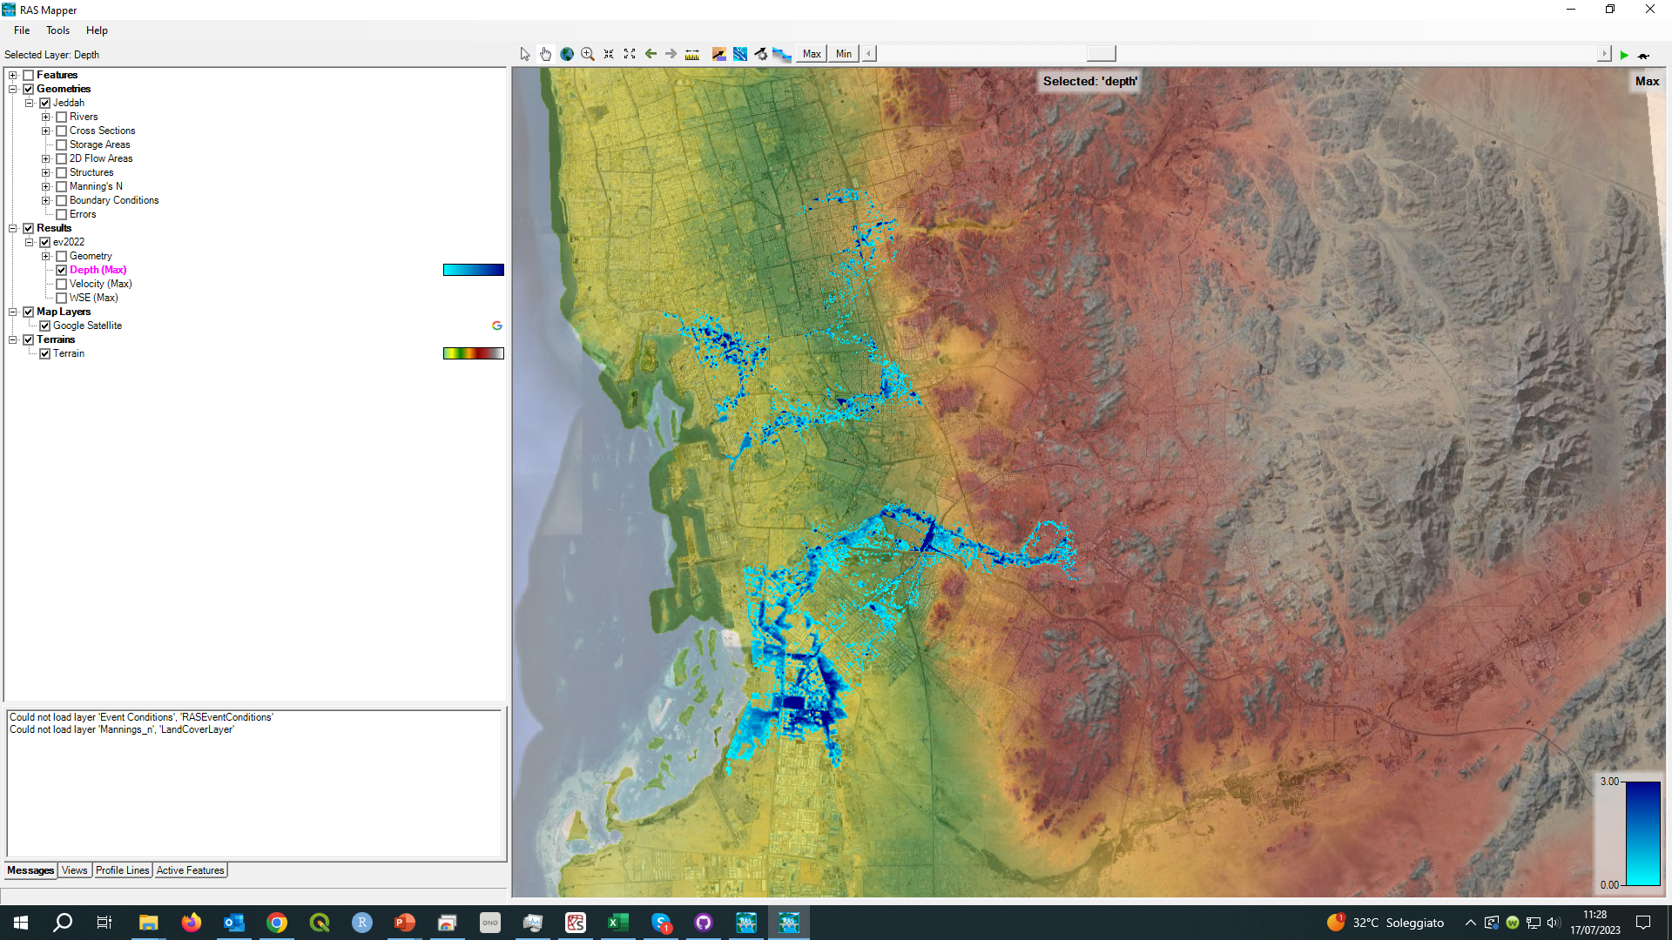
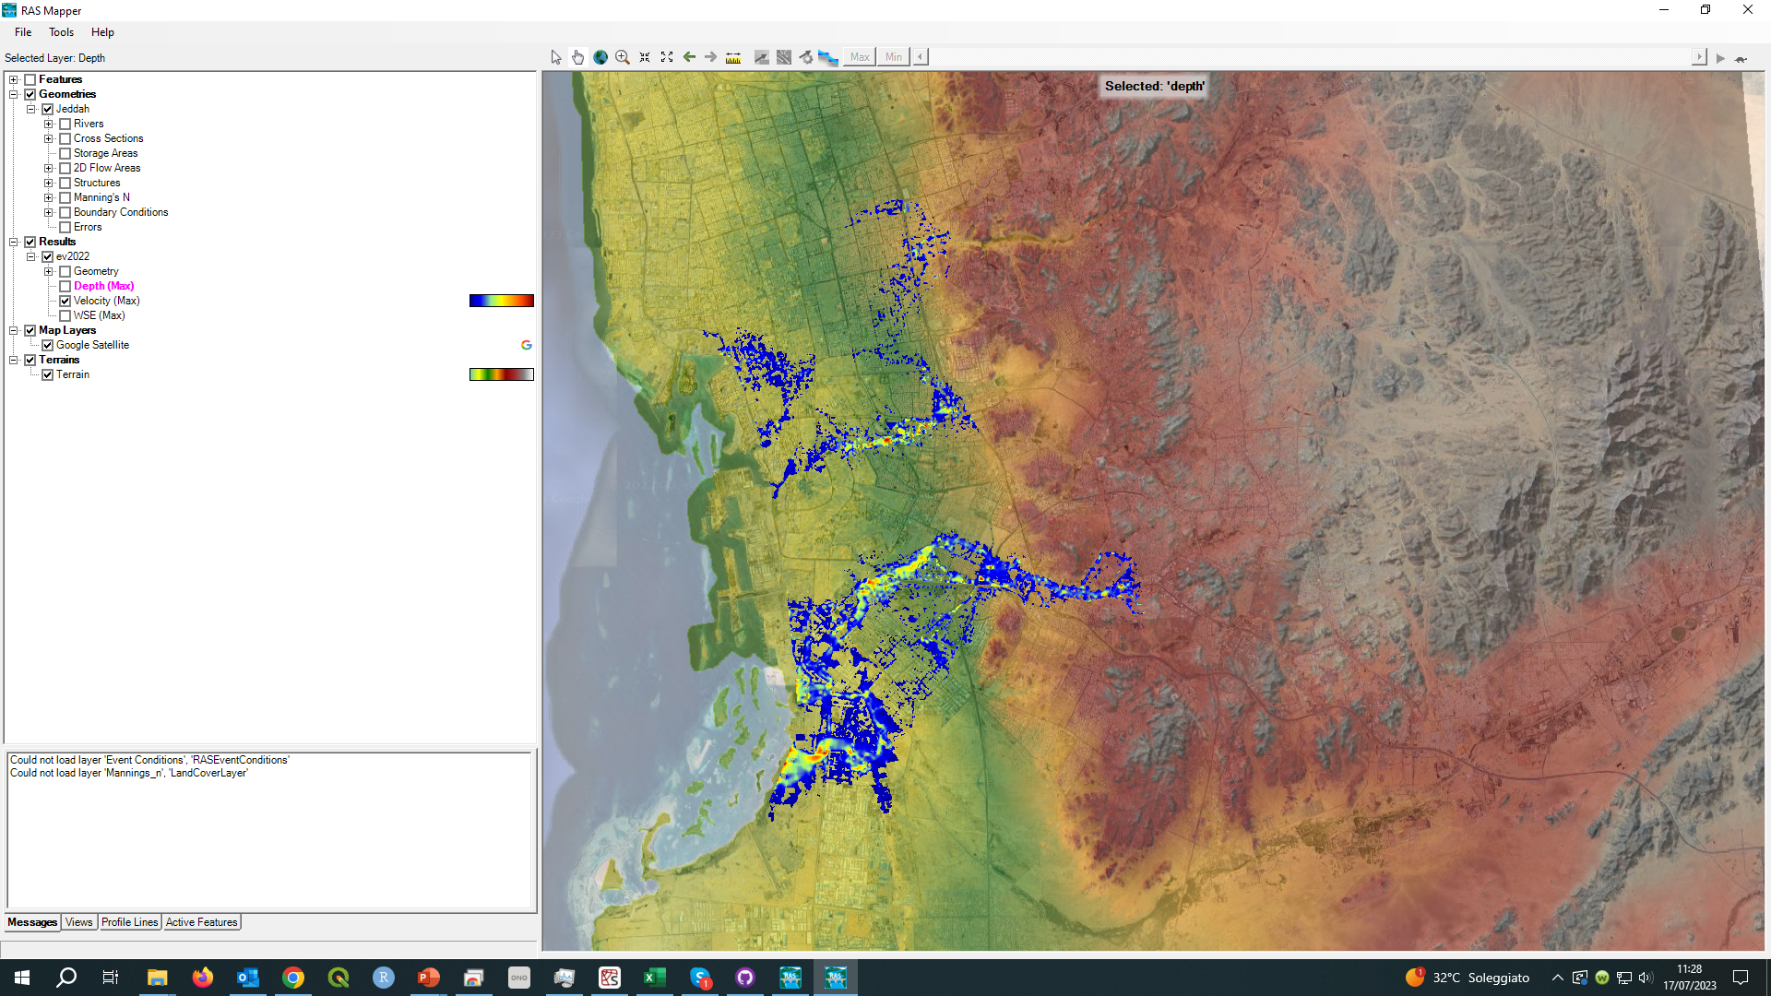
HEC-RAS outputs
Giulia Sofia, PhD

Slide 2
Overview
1. Where and How to Access HEC-RAS Output
2. Output and Visualization Options
3. RasMapper

Slide 3

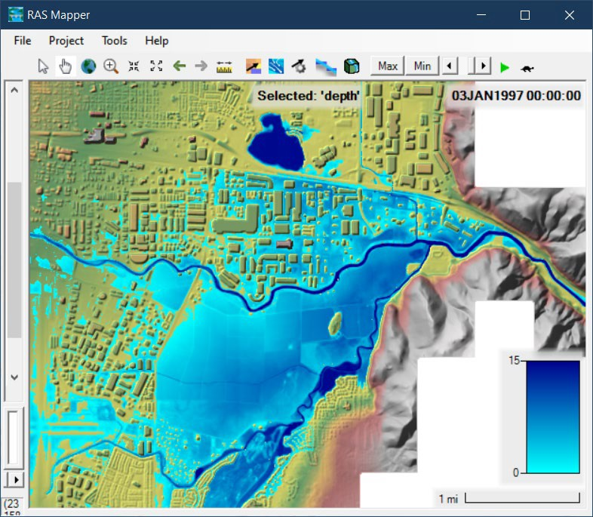


Overview
*.p01
*.p01.HDF

Slide 4
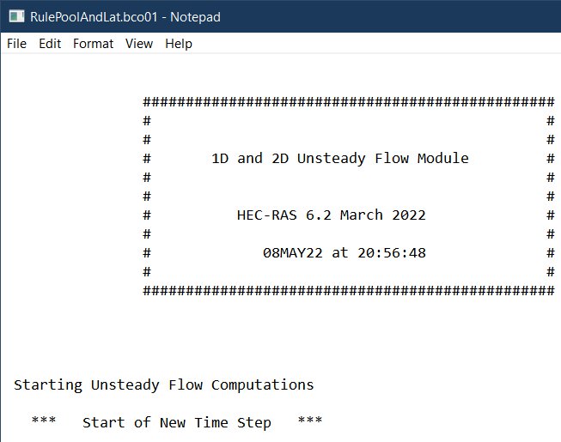
Overview
Computation Log
*.p01
*. bco01

Slide 5
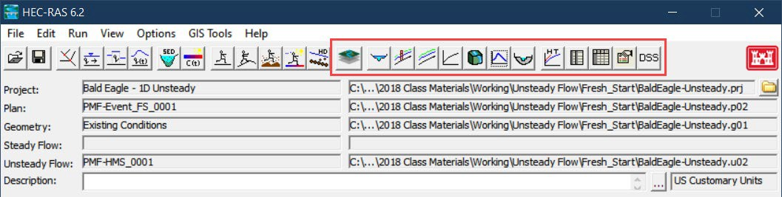
Where do I find them

Slide 6
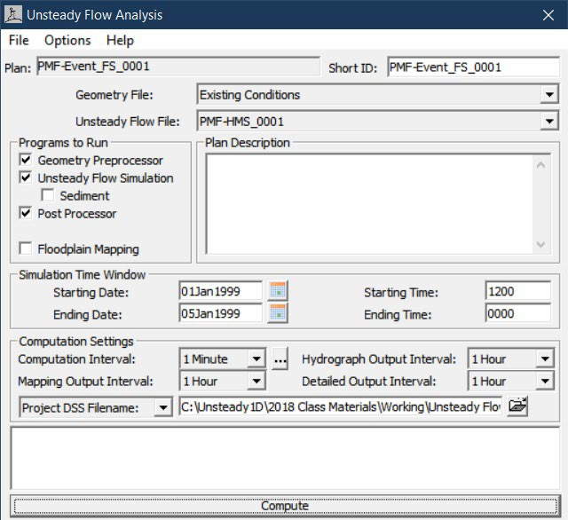
Computational output interval
Must be:
Greater than computation timestep
Divisible by computation timestep
Hydrograph Output Interval
Stage and Flow Hydrographs
Detailed Output Interval
Post-Processor
Mapping
RAS Mapper

Slide 7
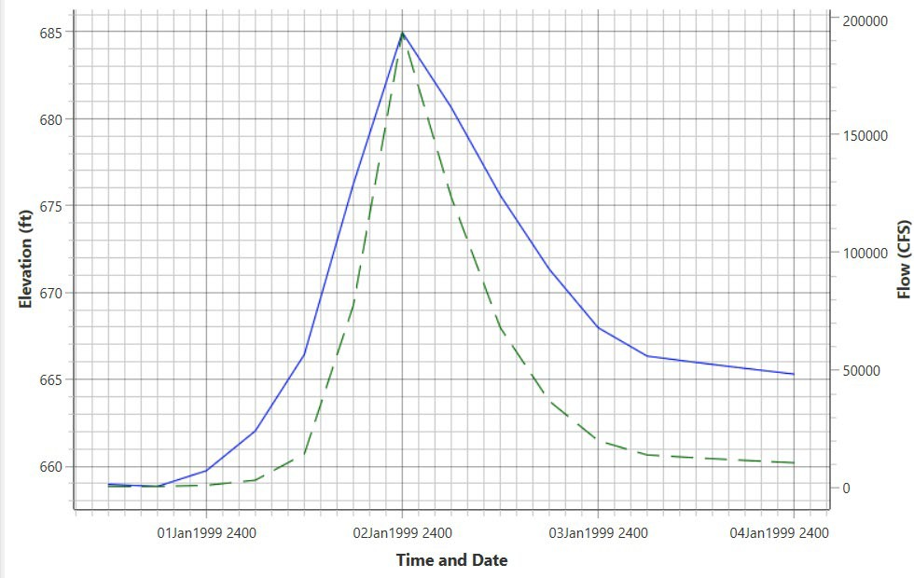
Importance of output interval
Too coarse
Miss peaks
Blocky hydrographs
Rough animations
Bad for troubleshooting
Too fine
Large output files
Long post-process time

Slide 8
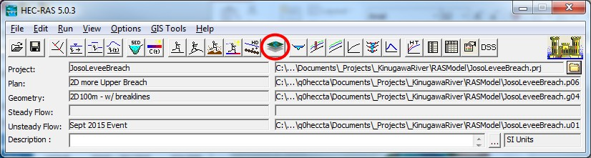
RASMAPPER

Slide 9
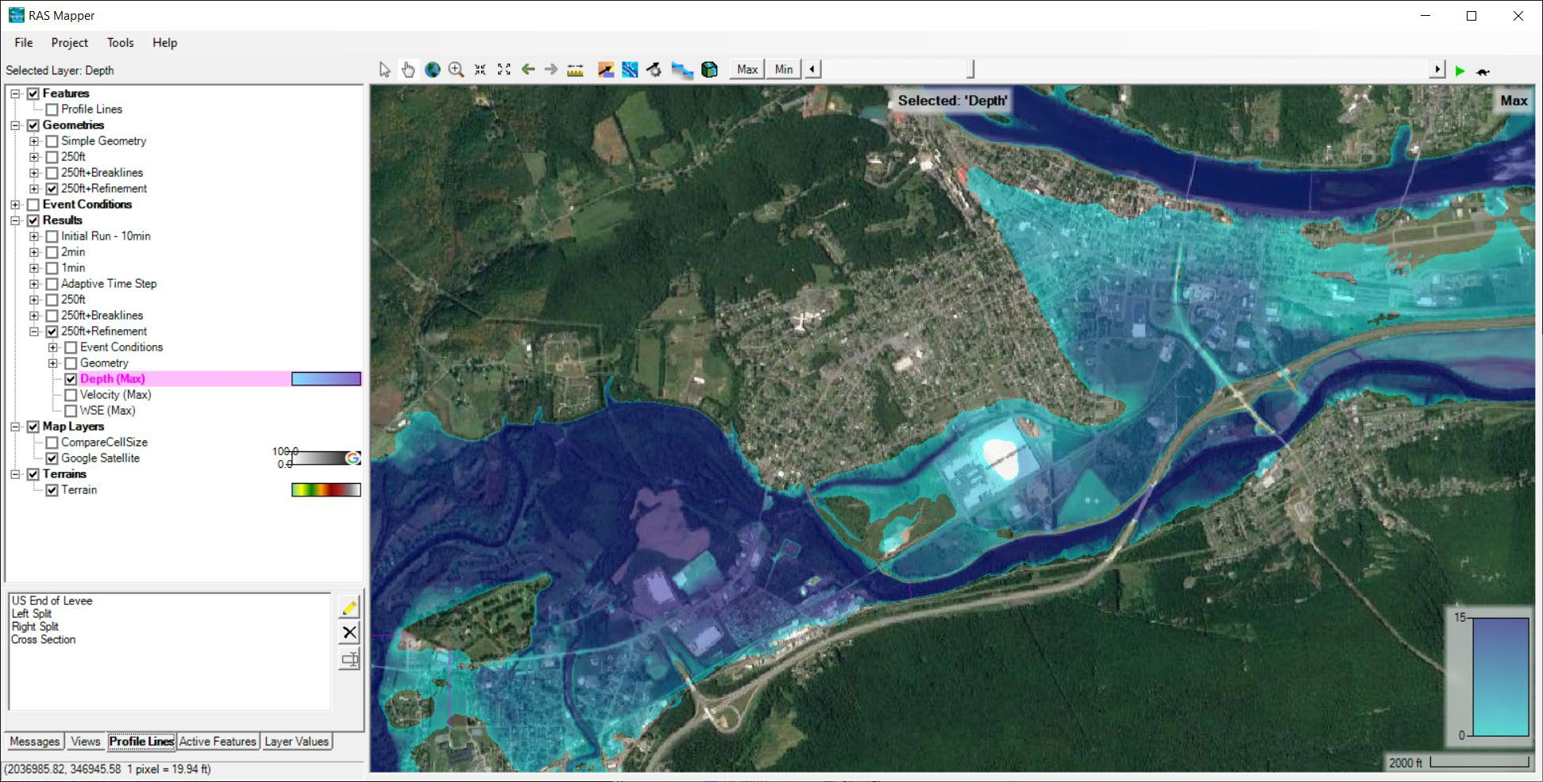
RASMAPPER
View Tools
Animation Controls
Layers List
Status Area
View Area

Slide 10
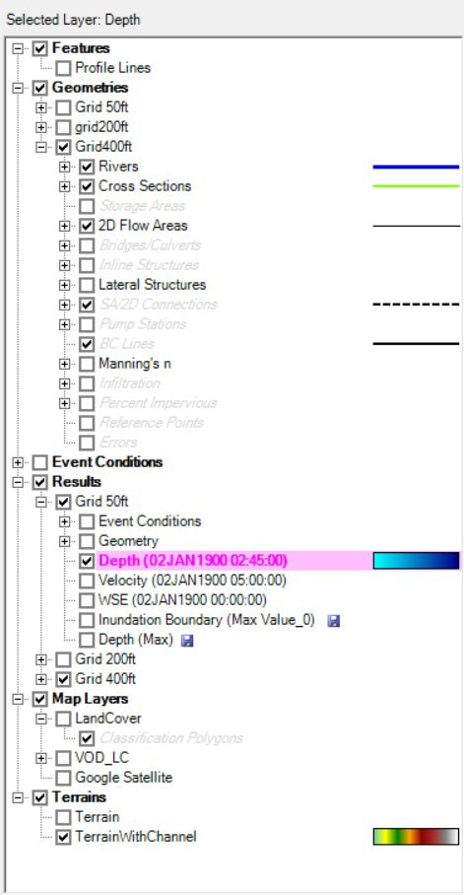
RASMAPPER
Symbology is shown to the right of any checked layers.
Layers List
Profile Lines
Geometries
Results
Map Layers
Terrains
The selected layer is highlighted in magenta.

Slide 11
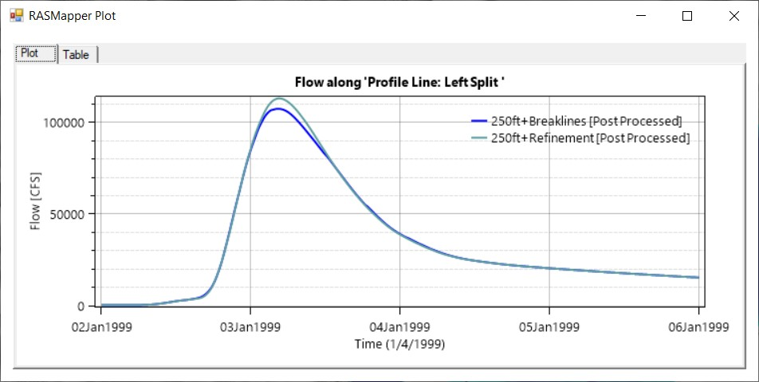
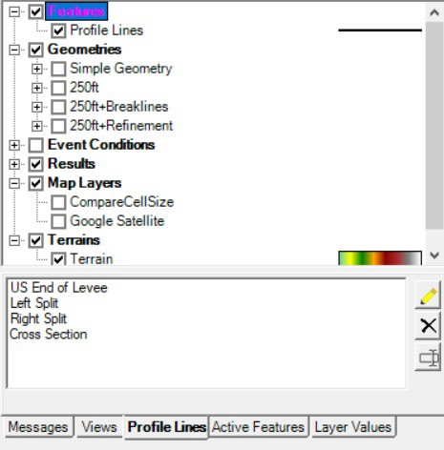
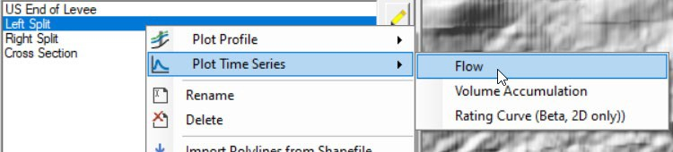
RASMAPPER
Profile Lines

Slide 12
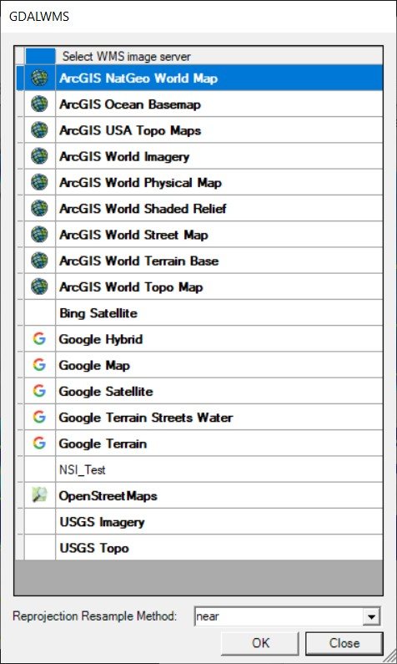
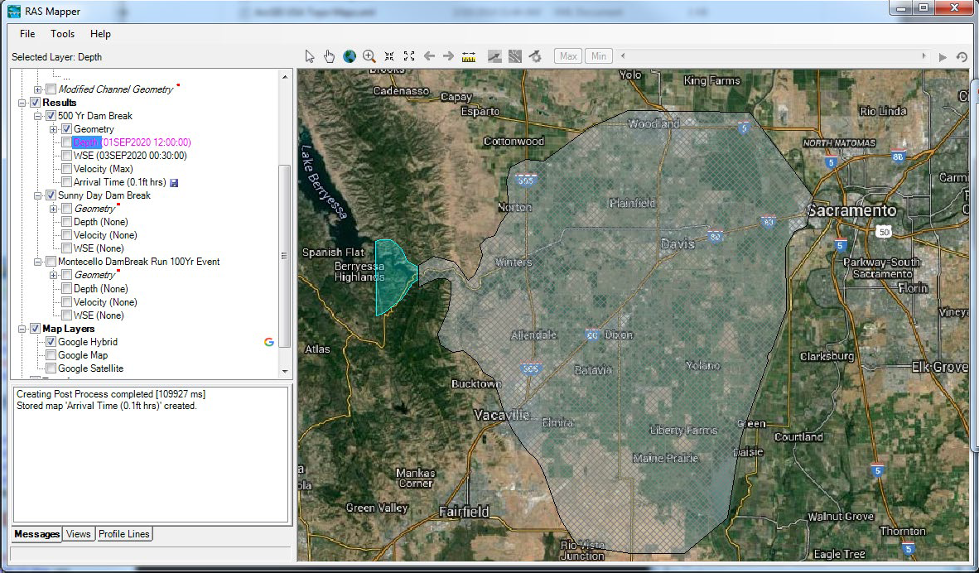
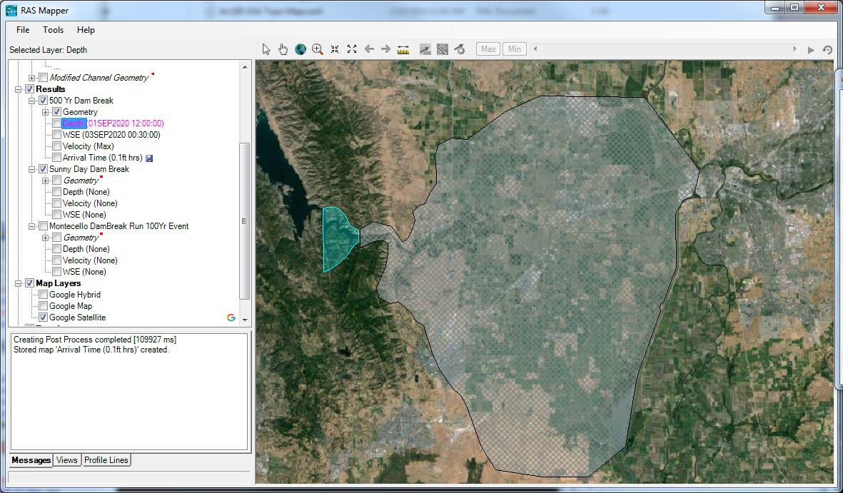
RASMAPPER
Web imagery

Slide 13
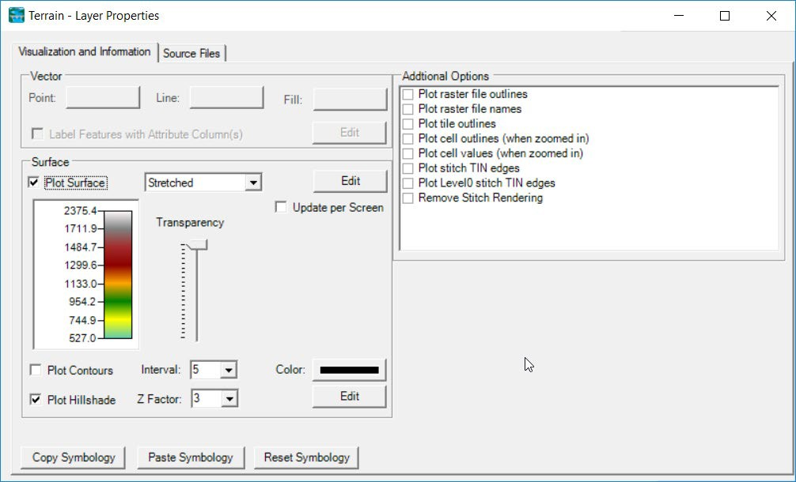
RASMAPPER
Terrain
Plot options

Slide 14
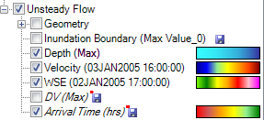
RASMAPPER
Dynamic Mapping – on-the-fly mapping
Animation of results without waiting
Stored Maps – results written to file
* = There was a problem reading data

Slide 15
RASMAPPER
Depth
Velocity

Slide 16
Map Types – Dynamic vs Stored
Dynamic: Computed on-the-fly
Smooth: Computes to screen-resolution
Doesn’t use disk space
Stored: Computed to terrain resolution
Stored to disk
Faster rendering for slow map types

Slide 17

Dynamic vs Stored Results
Dynamic results plot values for the current pyramid level. Boundaries are defined based on interpolation.
Stored results have a single value per cell.

Slide 18
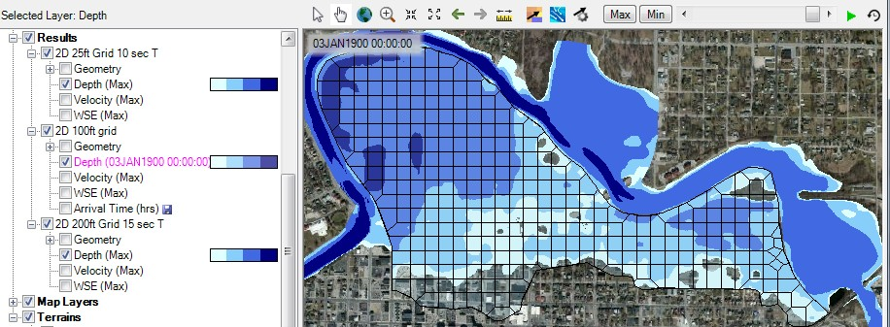
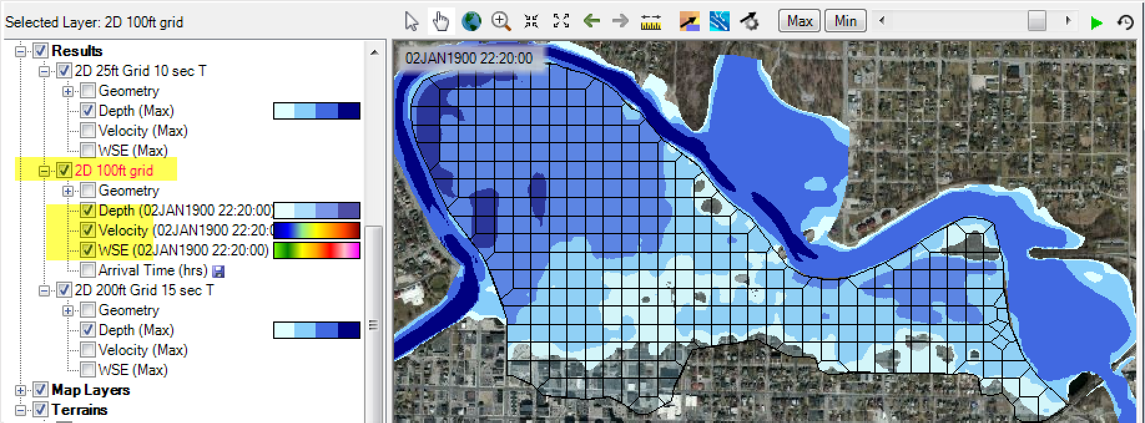
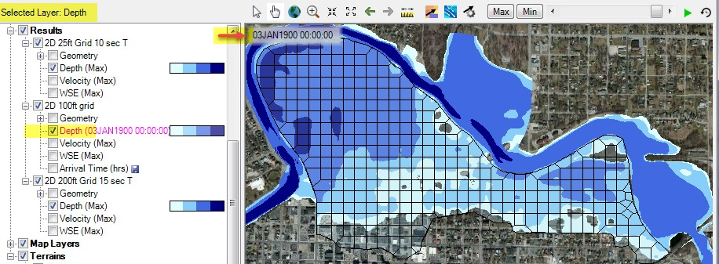
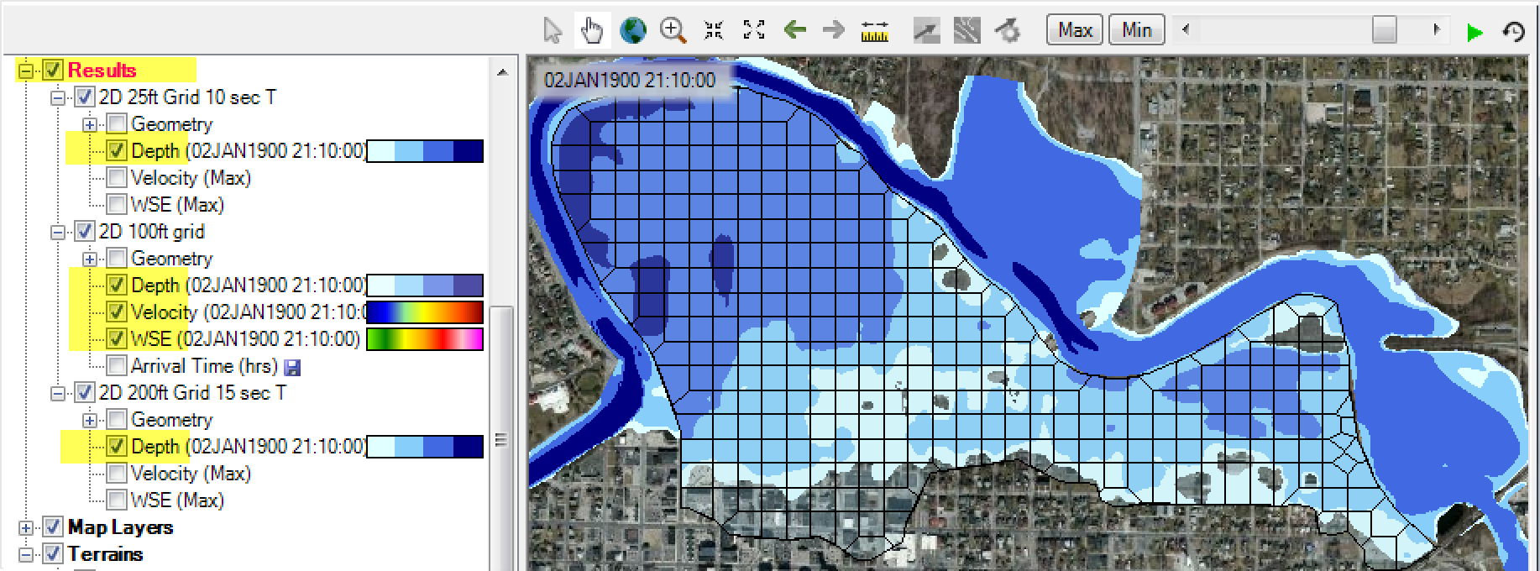
Dynamic Mapping
Animation Toolbar – works on selected layer or group and syncs the timestep

Slide 19
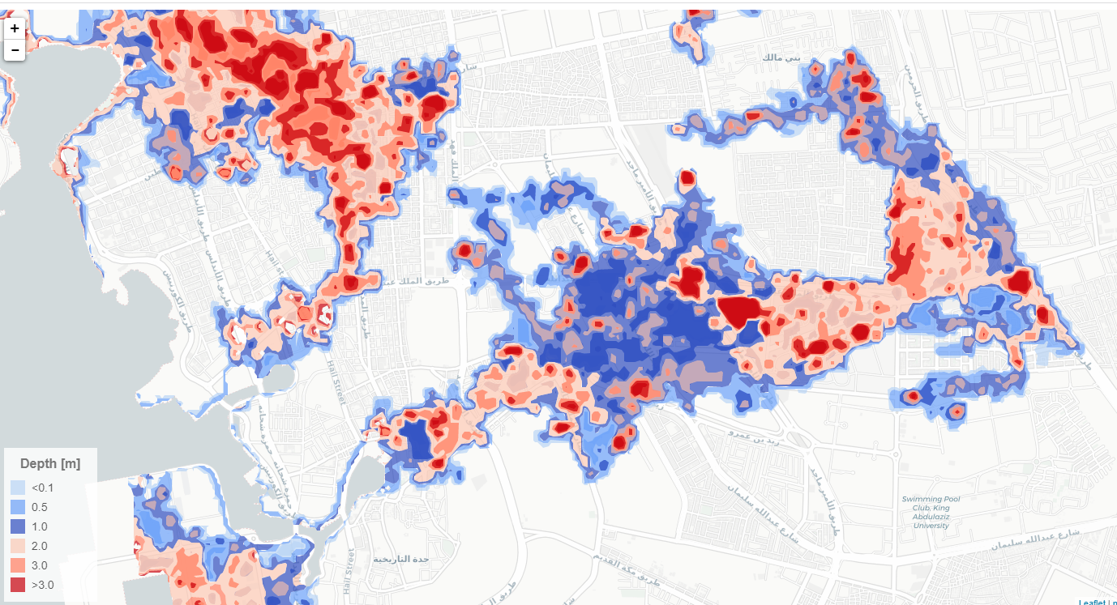
The NCM system
Maps are interpolated at a single resolution [same as terrain data] and displayed on the web interface as geojsons
Stored results are the geojson files within the html

Slide 20
Questions?
33

